Slide 1
Developing a neural network (The Luna lada Game)
Onyemelonu Nneoma Charity
PG Number: 2207938

Slide 2
Goals/Objectives
The primary purpose of this activity is to be able to develop and train a neural network, that can effortlessly play the Luna Landa game and attain correct scores. This was achieved by:
Data Collection
Data Pre-Processing
Neural Network Architecture
Forward and Backward Propagation
Trials/Implementation

Slide 3
Data collection
The game was played by me and after some minutes of trials, generated four columns of data, where the first two are identified as the X and Y distances to target, while the last two represents the velocity of X and Y respectively, with an 8813 rows of inputs.

Slide 4
The Data Pre-processing
After the importation and description of the data collected, it was pre-processed with the following steps:
Cleaning
The Data was described and null values were indicated as false
Normalization
Data was normalized using the min-max feature scaling, within 0 and 1, with the formula : x’ = (x-x.min)/(x.max – xmin)
Splitting
The data was then split into two at first with a ratio of 0.80 ratio to generate a train and test data. The train set was further spitted with a ratio of 0.10 to a final train set and a validation set

Slide 5
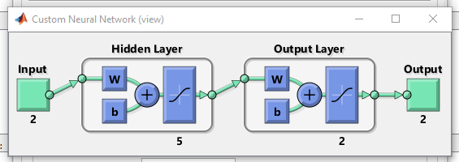
the neural network architecture
Using MatLab, the splitted data was uploaded using basic variables of 2 inputs, 5 neurons on the hidden layer and 2 output.

Slide 6
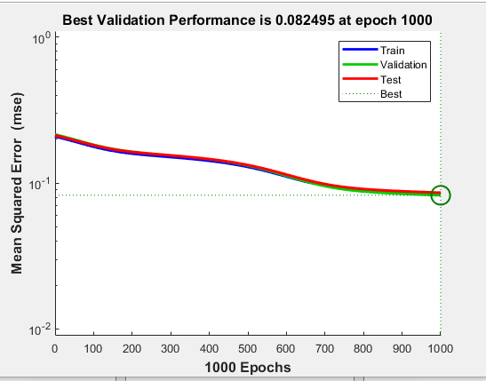
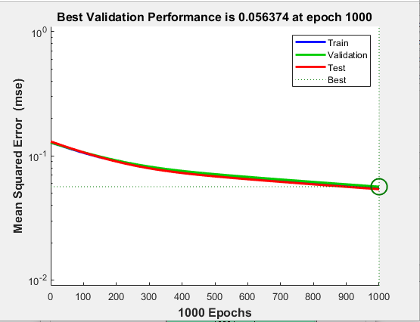
Performance result
Using 6 neurons for the hidden layer
Using 5 neurons for the hidden layer

Slide 7
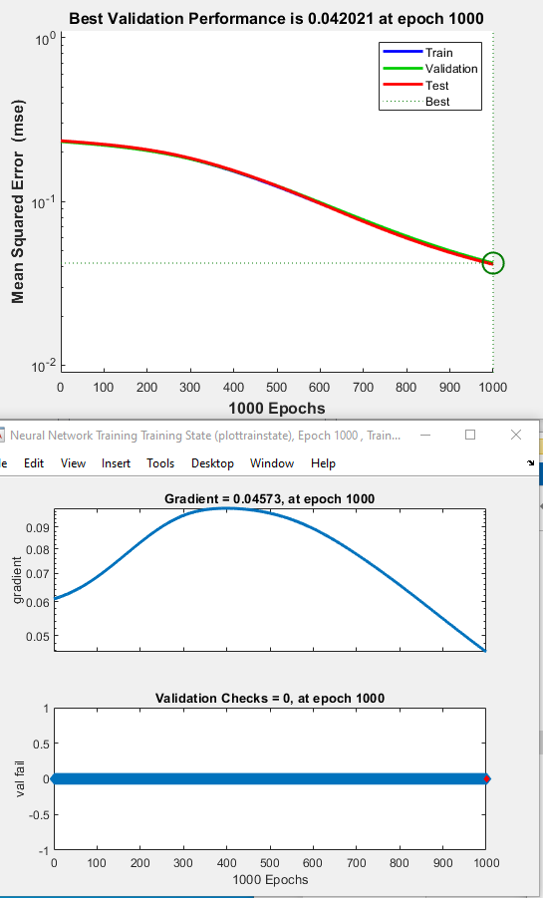
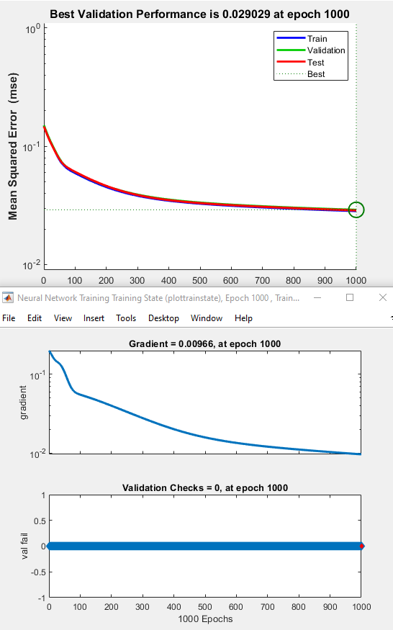
Performance Results
After Changing the learning rate to 0.006 it resulted to this:

Slide 8
Parameters used for the neural network
Sigmoid Function and its derivative
Loss Function
Gradient Descent

Slide 9
RMSE and early stopping criteria

